Slide 1


3D Graphics Rendering and Terrain Modeling
Technology and Historical Overview
By Ricardo Veguilla

Slide 2

Overview
Introduction to 3D Computer Graphics
OpenGL
SGI vs Linux
3D Animation
Terrain Modeler: Project Status

Slide 3
Introduction to 3d Computer Graphics
3D computer graphics is the science, study, and method of projecting a mathematical representation of 3D objects onto a 2D image using visual tricks such as perspective and shading to simulate the eye's perception of those objects.

Slide 4
3D Graphics and Physics
3D graphic software is largely based on simulating physical interactions.
Generally:
  Space relations.
  Light interactions.
In particular cases:
  Material properties.
  Object Movement.

Slide 5
Goals of 3D computers graphics
Practical goal:
Visualization - to generate images (usually of recognizable subjects) that are useful in some way.
Ideal goal:
Photorealism - to produce images indistinguishable from photographs.

Slide 6
Components of a 3D Graphic System
3D Modeling:
  A way to describe the 3D world or scene, which is composed of mathematical representations of 3D objects called models.
3D Rendering:
  A mechanism responsible for producing a 2D image from 3D models.

Slide 7
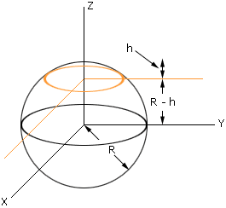
3D Modeling
Simple 3D objects can be modeled using mathematical equations operating in the 3-dimensional Cartesian coordinate system.
Example:
the equation x² + y² + z² = r²
is a model of a perfect sphere with radius r.

Slide 8
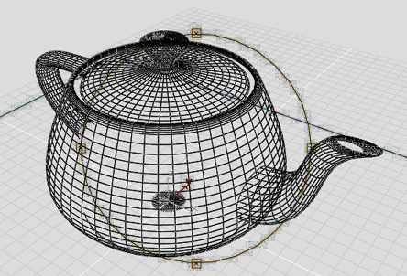
Modeling considerations
Pure mathematical equations to represent 3D objects requires a great deal of computing power
Impractical for real-time applications such as games or interactive simulations.

Slide 9
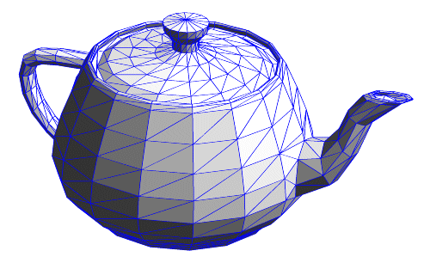
Alternatives: Polygon Models
Modeling objects by sampling only certain points on the object, retaining no data about the curvature in between
More efficient, but less detailed.

Slide 10
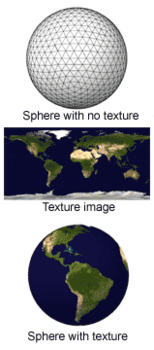
Alternatives: Texture Mapping
Technique used to add surface color detail without increasing the complexity of a model.
An image is mapped to the surface of a model.

Slide 11
From 3D models to 2D images
A 3D world or scene is composed of collection of 3d models
Three different coordinates systems (or spaces) are defined for different model related operations:
  Object Space
  World Space
  Screen Space

Slide 12
Object Space
The coordinate system in which a specific 3D object is defined.
Each object usually have its own object space with the origin at the object's center
The object center is the point about which the object is moved and rotated.

Slide 13
World Space
World space is the coordinate system of the 3D world to be rendered.
The position and orientation of all the models are defined relative to the center of the world space.
The position and orientation of the virtual camera is also defined relative to the world space.

Slide 14
Screen Space
2D space that represents the boundaries of the image to be produced.
Many optimization techniques are performed on screen space.

Slide 15
Mathematics of 3D graphics
3D operations like translation, rotation and scaling are performed using matrices and lineal algebra.
Each operation is performed by multiplying the 3D vertices by a specific transformation matrix.

Slide 16
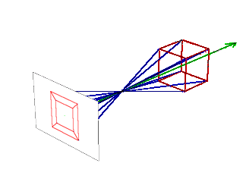
3D Rendering
The process of taking the mathematical model of the world and producing the output image.
The core of the rendering process involves projecting the 3D models onto a 2D image plane.

Slide 17
Types of Rendering Algorithms
Two general approaches:
  Pixel-oriented rendering:
    Ray tracers
  Polygon-oriented rendering:
    Scan-line renderers

Slide 18
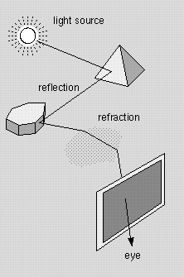
Ray tracers
Operates by tracing theoretical light rays as they intersect objects in the scene and the projection plane.

Slide 19
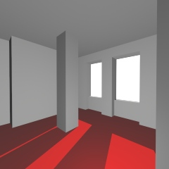
Ray tracer limitations
Processor intensive. A full ray tracer is impractical for real-time applications.
Does not take into account inter-reflections of diffuse light, resulting in hard shadows.

Slide 20
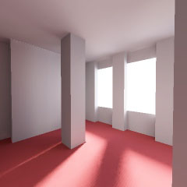
Radiosity
Technique that models the inter-reflections of diffuse light between surfaces of the world or environment.
Produces more photorealistic illumination and shadows.

Slide 21
Scan-line renderers
  Operate on an object-by-object basis, directly drawing each polygon to the screen.
  Requires all objects – including those modeled with continuous curvature – to be tessellated into polygons.
  Polygons are eventually tessellated into pixels.

Slide 22
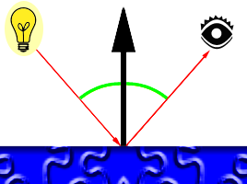
Illumination for scan-line renderers
Lighting and shading is calculated using the normal vector.
The color is linearly interpolated across the polygon surface.

Slide 23
Common shading techniques scan-line renderer
Flat shading
Gouraud Shading
Phong Shading

Slide 24
Flat Shading
The color of the polygon is calculated at the center of the polygon by using the normal vector.
The complete polygon surface is uniformly lighted.

Slide 25
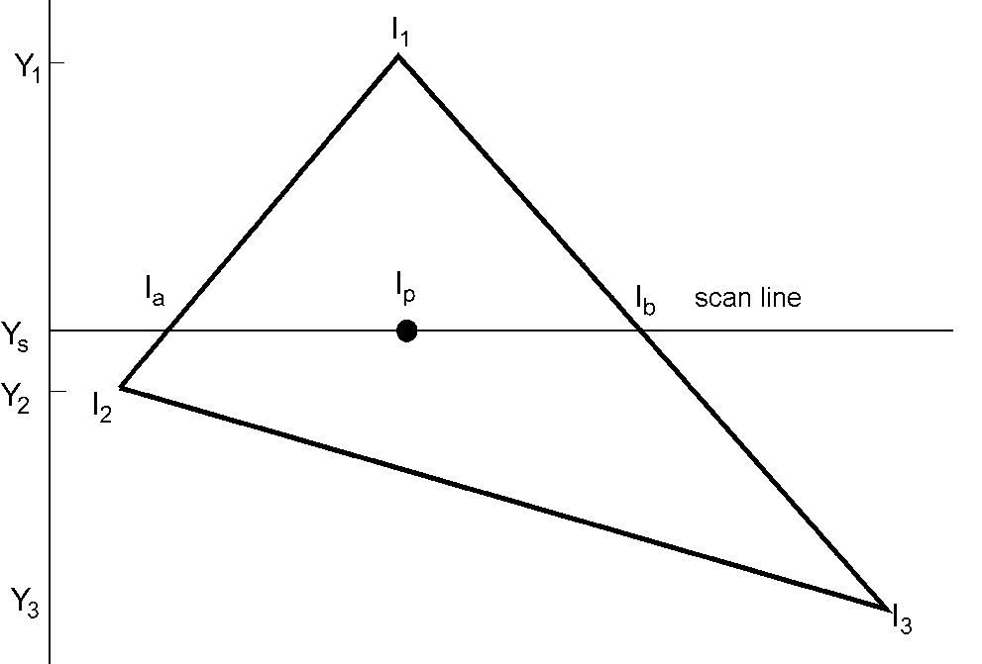
Gouraud Shading
A normal vector is calculated at each vertex.
Color is calculated for each vertex and interpolated across the polygon

Slide 26
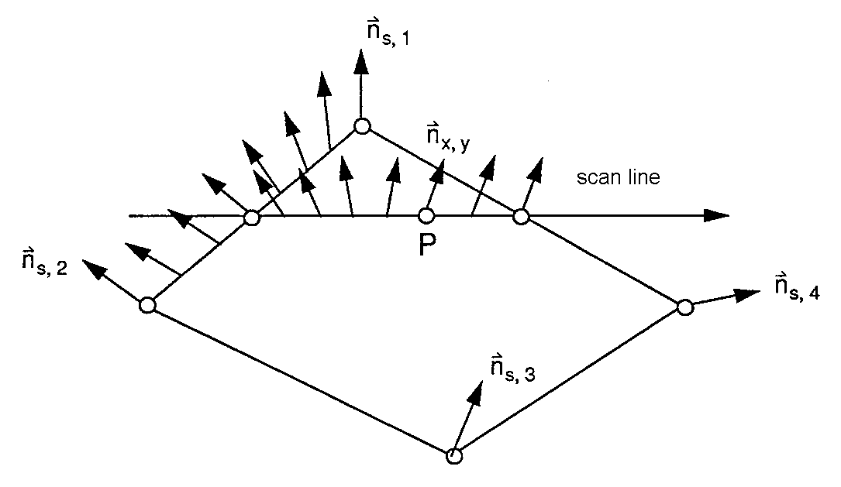
Phong Shading
The normal vectors are interpolated across the surface of the polygon
The color of each point within the polygon is calculated from its corresponding normal vector

Slide 27
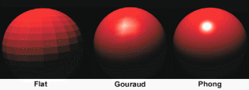
Polygon shading techniques compared

Slide 28
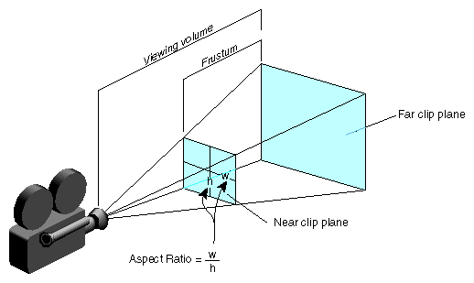
Viewing frustum
Segment of the 3D world to be rendered
Objects outside the viewing volume are ignored.

Slide 29
Hidden surface determination
Not all objects inside the viewing frustum are always visible from the point of view of the camera.
Not all polygons of a particular object are visible from the point of view of the camera.
Common Techniques
  Painters Algorithm
  Z-Buffering

Slide 30

Painter’s Algorithm
Polygon-oriented.
All the polygons are sorted by their depth and then displayed in this order.

Slide 31
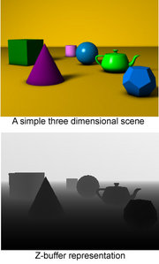
Z-Buffering
Pixel-oriented.
When multiple objects overlap (from the point of view of the camera) on a particular pixel, only the value of the pixel closest to the camera is used.
Implemented by saving the depth value of each displayed pixel in a buffer, and comparing the depth of each new overlapping pixel against the value in the buffer.

Slide 32
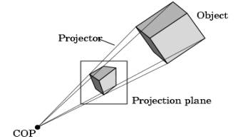
Perspective Projection
Projects the 3D world to a 2D image

Slide 33
References:
Wikipidia – The Free Encyclopedia
  http://www.wikipedia.org/
OpenGL - The Industry Standard for High Performance Graphics
  http://www.opengl.org/
Google Image Search
  http://images.google.com
Overview of 3D Interactive Graphics
  http://www.siggraph.org/project-grants/com97/com97-tut.html
Linux Journal - Industry of Change: Linux Storms Hollywood
  http://www.linuxjournal.com/article/5472
JCanyon - Grand Canyon Demo
  http://java.sun.com/products/jfc/tsc/articles/jcanyon/

